Slide 1

UBER SUPPLY-DEMAND GAP
- Giang Nguyễn -

Slide 2

TABLE OF CONTENTS
01
03
02
04
Understand Business Goal
EDA
Define business goal by logic tree
Validate hypothesis by explore data analytics
Plan of Analytics
Recommendation
4 steps of data analytics process to achieve the goal
Some recommendations and KPIs to monitor

Slide 3
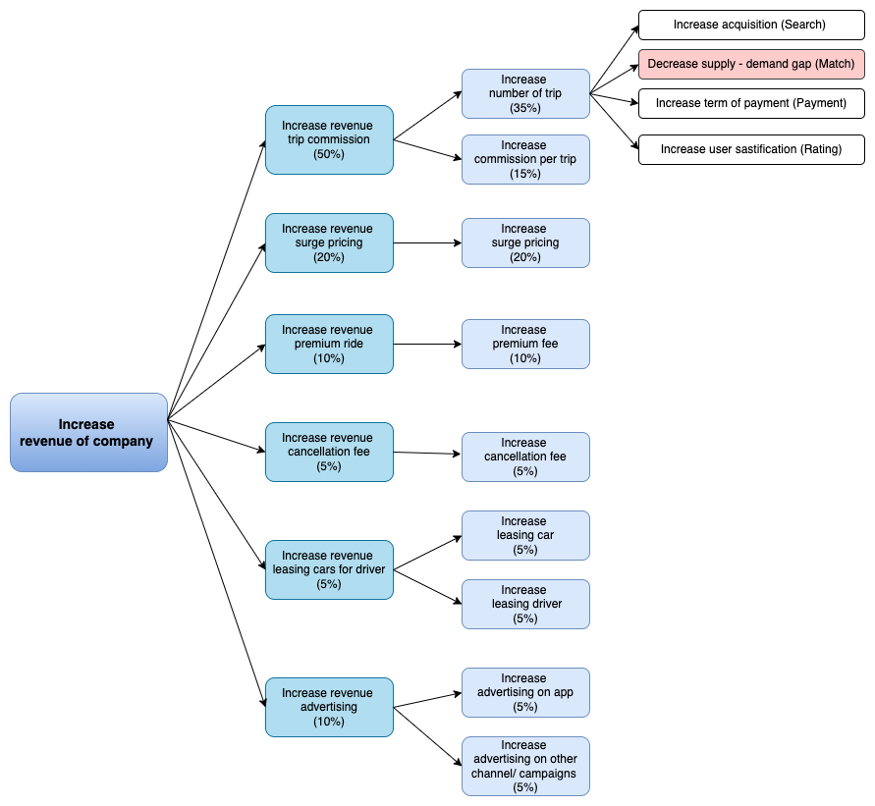
UNDERSTANDING THE PROBLEM
Objective:
Identify the gap between supply and demand of Uber
Possible hypotheses of the problem
Recommend ways to improve the situation.
=> From that, we can increase the number of trip ->increase revenue from commission trip, thereby increase the revenue of company

Slide 4
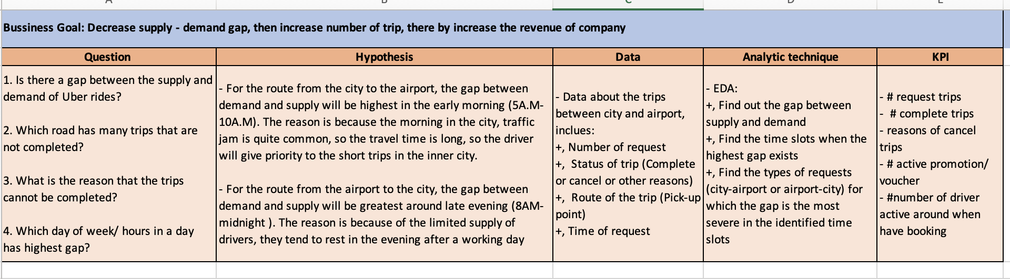
PLAN OF ANALYTICS
Hypothesis:
For the route from the city to the airport, the gap between demand and supply will be highest in the early morning (5A.M - 10A.M). The reason is because the morning in the city, traffic jam is quite common, so the travel time is long, so the driver will give priority to the short trips in the inner city.
For the route from the airport to the city, the gap between demand and supply will be highest around late evening (8AM - midnight ). The reason is because of the limited supply of drivers, they tend to rest in the evening after a working day

Slide 5
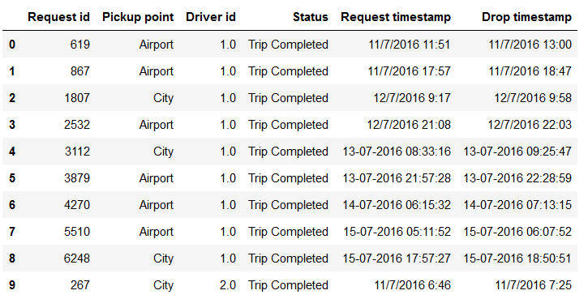
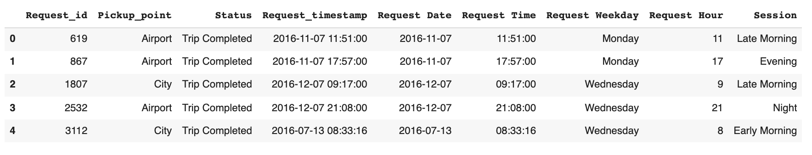
EXPLORE DATA ANALYSIS
Data preparation
Issues:
Data set contains 6 columns:
Request.id
Pickup.point
Driver.id
Status
Request.timestamp
Drop.timestamp
Checking missing and duplicated data
Request time stamp is object here. Convert it to date time format.
Change column name for easier analysis
Drop unnecessary columns: driver_id, drop time
Add more columns: Day of week, hour and sessions in a day

Slide 6
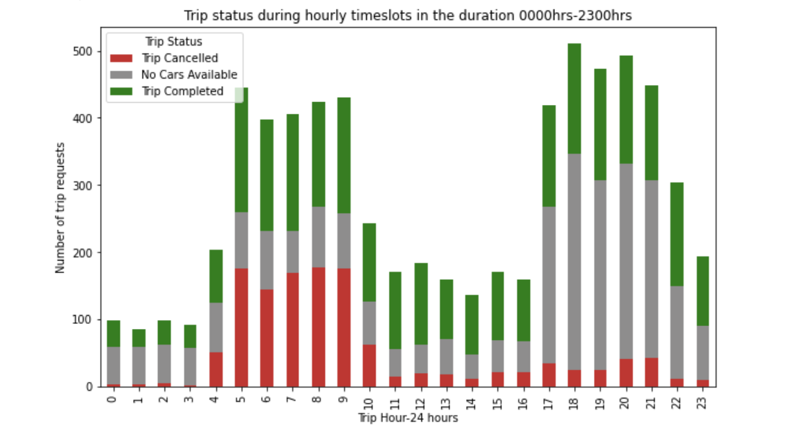
Hour Demand Analysis
Uber has highest demand from 5p.m - 10p.m and 5a.m - 10a.m.

Slide 7
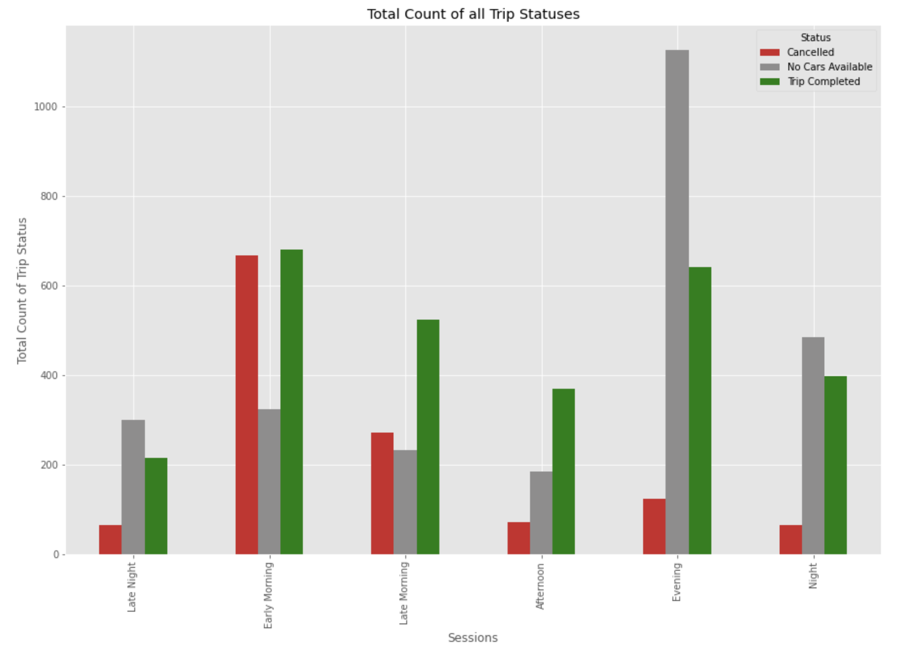
Overall Observation
Divide trips into 6 session details:
- Late Night: Midnight to 4AM
- Early Morning: 4AM - 8AM
- Late Morning: 8AM - Noon
- Afternoon: Noon - 4PM
- Evening: 4PM - 8PM
- Night: 8PM - Midnight
Maximum number of "No Cars Available" status trips can be seen in Evening Session, followed by Night session
Maximum number of "Cancelled" status trips can be seen in Early Morning Session, followed by Late Morning session

Slide 8
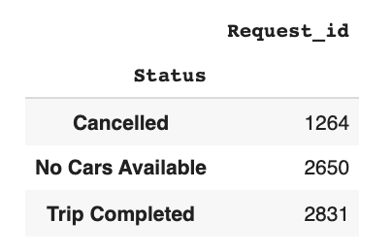
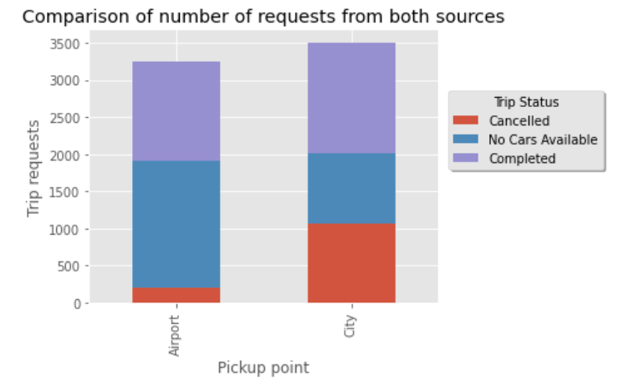
Analysis Trip Status
There is a very big supply demand gap. Only 42 percent of the total trip requests are being completed. There are a total of 19 percent trips that are being cancelled by the driver There are 39 percent trip requests which are being turned down due to unavailability of cars .
Hence a bigger problem is car unavailability and need to be tackled depending on the where the request is coming from Airport or city

Slide 9
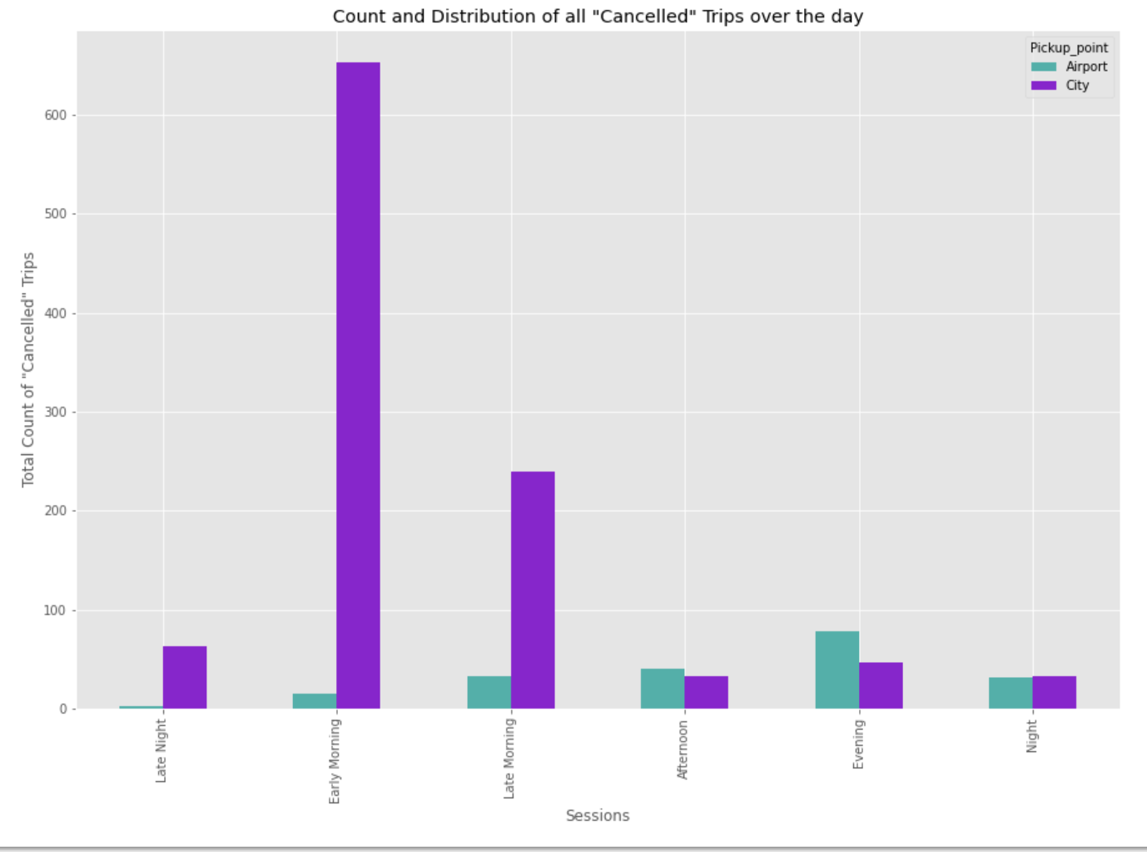
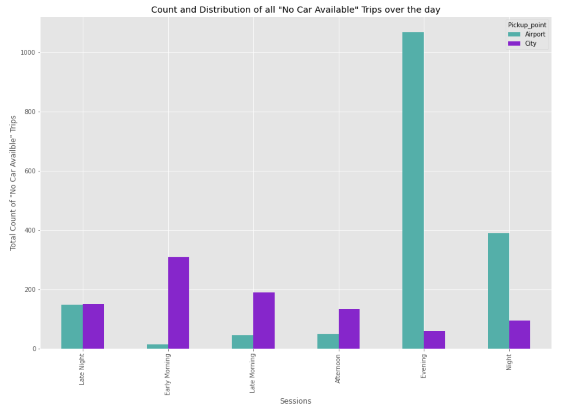
Analysis Trip Status
Most number of Cancellations happen in the Morning hours (4AM-8AM) in the City to Airport route
Most number of No Cars Available happen in the Evening Hours (4PM-8PM) in the Airport to City route

Slide 10
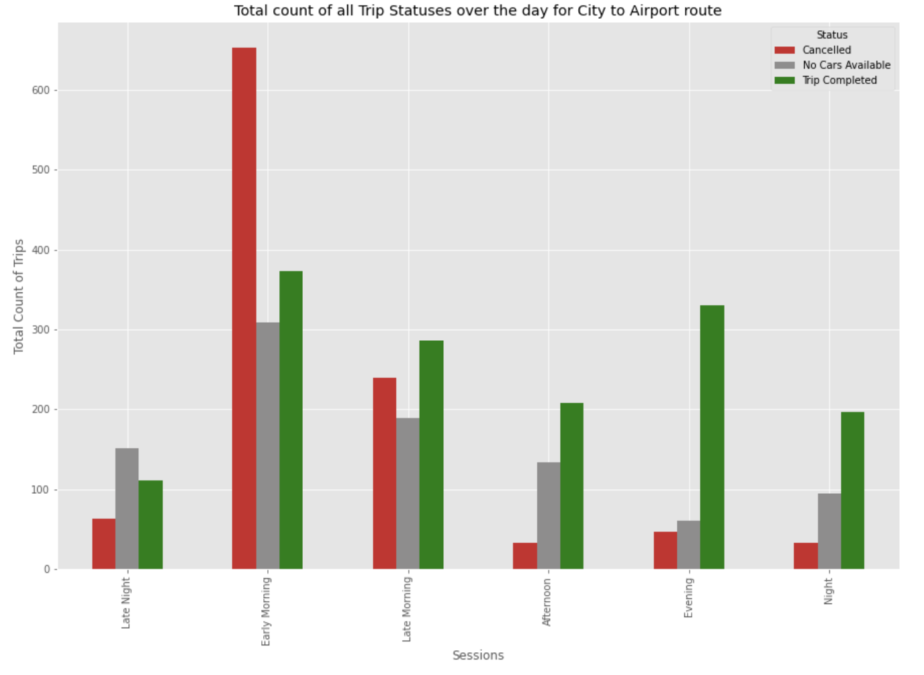
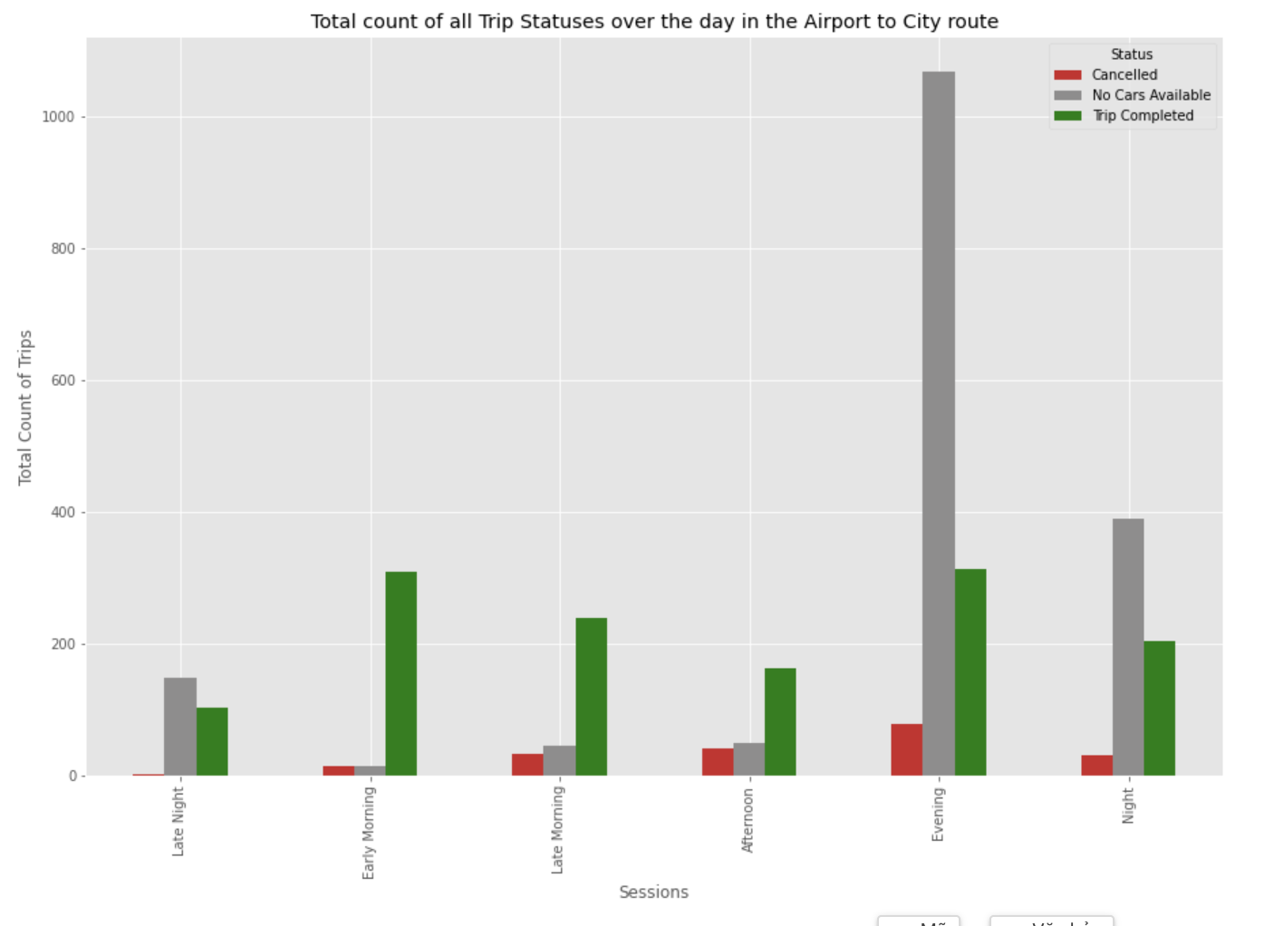
Pick-up Point Analysis
We see that maximum trips are cancelled from City to airport in the Early Morning session followed by Late Morning Session
We see that maximum number of "No Cars Available" from Airport to city in the Evening session followed by Night Session

Slide 11
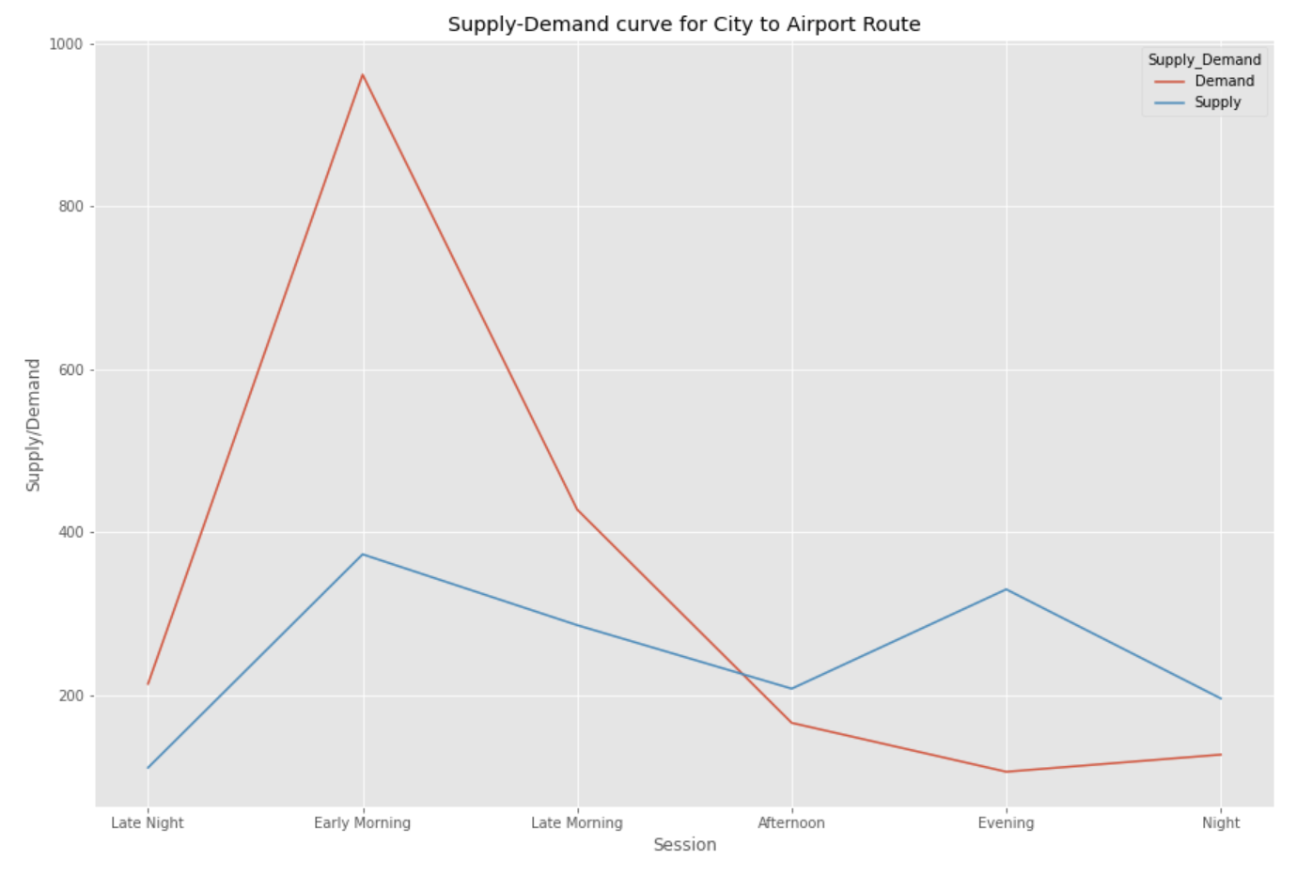
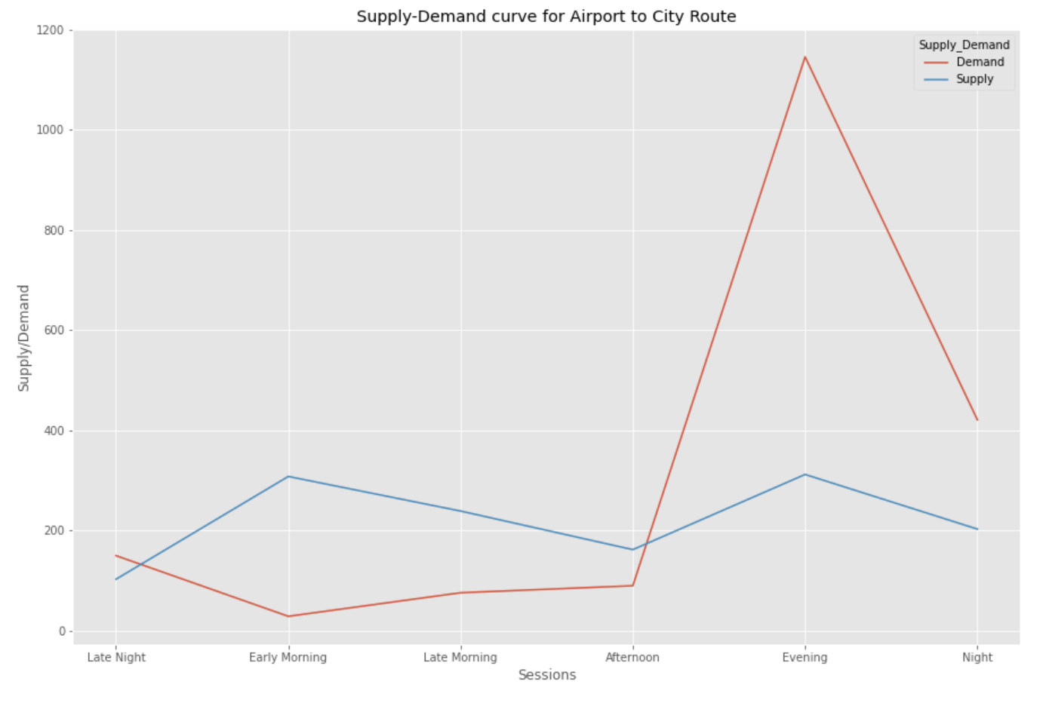
Supply – Demand Gap Analysis
The demand is very high in the morning from City to Airport route but the supply is very low
The demand is very high in the evening in the Airport to City route but the supply is very low

Slide 12
Validate Hypothesis
For the route from the city to the airport, the gap between demand and supply will be highest in the early morning and late morning(4A.M-12A.M). The reason is not only because of traffic jam in the city morning so the driver will give priority to the short trips within city but also the demand during morning and afternoon hours from the Airport to City is quite low, which means that a driver who completed a City to Airport route in the morning hours may have to wait a really long time to get a ride back to the City, or he may have to come back without a passenger. Both situations are not idle for drivers, which might be the reason for highest number of "Cancelled" trips in the City to Airport trip in the morning hours
For the route from the airport to the city, the gap between demand and supply will be highest around late evening (5PM-midnight ). The reason is because of the limited supply of drivers, not only they tend to rest in the evening after a working day but there are too many flight coming in to the airport and hence there is a high demand for cabs and not enough supply. which is why most number of "No Cars Available" were observed in Evening in the Airport to City route.

Slide 13
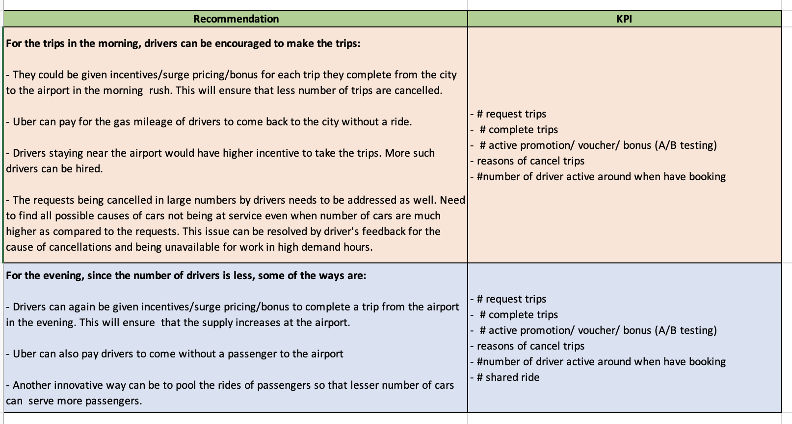
RECOMMENDATIONS

Slide 14

THANKS!
Do you have any questions?

